Slide 1
CSE460: VLSI Design
Lecture 8: Finite State Machines (Part 1)

Slide 2
A very simple controller[ a light switch!!]
Light OFF -> Light OFF [same state] [switch OFF, w=0]
Light OFF -> Light ON [change of state] [switch ON, w=1]
Light ON -> Light ON [same state] [Switch ON, w=1]
Light ON -> Light OFF [change of state] [switch OFF, w=0]
WHAT HAPPENS TO THE OUTPUT??
Light OFF -> z=0
Light ON -> z=1
w=1
Light OFF/z=0
Light ON/z=1
w=0
w=0
w=1

Slide 3
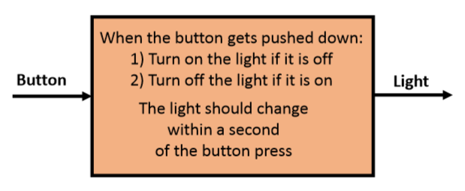
Let’s change the problem!!
What if you were given the following design specification:
What makes this circuit so different from those we’ve discussed before?

Slide 4
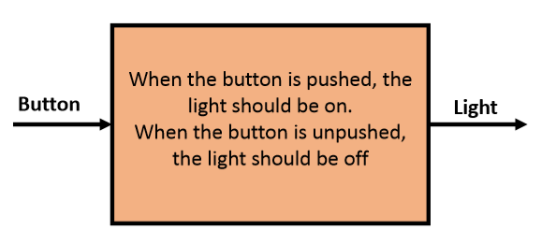
Something We Can Build (So Far)
What if you were given the following design specification:

Slide 5
What makes this circuit so different from those we’ve discussed before?
Specifications:
1. “State” –i.e. the circuit has memory (become “state‐ful”).
2. The output was changed by an input “event” (pushing a button) rather than an input “value” (output may depend on previous inputs).

Slide 6
Illustration of the previous example
Light OFF -> Light OFF [same state] [Button unpushed, w=0]
Light ON -> Light ON [same state] [Button unpushed, w=0]
Light OFF -> Light ON [change of state] [Button pushed, w=1]
Light ON -> Light OFF [change of state] [[Button pushed, w=1]
WHAT HAPPENS TO THE OUTPUT??
Light OFF -> z=0
Light ON -> z=1
w=1
Light OFF/z=0
Light ON/z=1
w=0
w=1
w=0

Slide 7
Example 1
An automatically-controlled vehicle is designed to run at some predetermined speed. However, due to some operational conditions the speed may exceed the desirable limit, in which case the vehicle has to be slowed down. To determine when such action is needed, the speed is measured at regular intervals.
Let a binary signal w indicate whether the speed exceeds the required limit, such that w = 0 means that the speed is within acceptable range and w = 1 indicates excessive speed.
The desired control strategy is that if w = 1 during two or more consecutive measurements, a control signal z must be 1 to cause the vehicle to slow down. Thus, z = 0 allows the current speed to be maintained, while z = 1 reduces the speed. Let a signal Clock define the required timing intervals, such that the speed is measured once during each clock cycle.

Slide 8
w
z
Example 1
FSM
clk
From previous example 1, we wish to design the circuit that meets the following specification:
The circuit has one input w, and one output z.
All changes in the circuit occur on the positive edge of a clock signal.
The output z is equal to 1 if during two immediately preceding clock cycle the input w was equal to 1. Otherwise the value of z is equal to 0.
Clockcycle: | t₀ | t₁ | t₂ | t₃ | t₄ | t₅ | t₆ | t₇ | t₈ | ^{t}9 ^{t}10
w : | 0 | 1 | 0 | 1 | 1 | 0 | 1 | 1 | 1 | 0 1
z : | 0 | 0 | 0 | 0 | 0 | 1 | 0 | 0 | 1 | 1 0
Figure 3 :
Sequences of input and output signals.

Slide 9
Example 1: A Simple Input Pattern (‘11’ Overlapping Sequence)
w
z
FSM
clk
OVERLAPPING 1’s
Clockcycle: | t₀ | t₁ | t₂ | t₃ | t₄ | t₅ | t₆ | t₇ | t₈ | ^{t}9 ^{t}10
w : | 0 | 1 | 0 | 1 | 1 | 0 | 1 | 1 | 1 | 0 1
z : | 0 | 0 | 0 | 0 | 0 | 1 | 0 | 0 | 1 | 1 0
Figure 4 :
Sequences of input and output signals.
The circuit detects two consecutive ‘1’. So, it must keep in memory how many ‘1’ it received in its input. So, a state diagram is introduced.
A state- no ‘1’ in input,
B state- one ‘1’ in input and
C state- two ‘1’ in input.
w=1
w=1
C= two 1’s
w=0, NS=A; w=1, NS= C
z = 1
A= No 1
B= one 1
1st clkcycle
w=0, NS=A; w=1, NS= B
z = 0
2nd clkcycle
3rd clkcycle
w=0, NS=A; w=1, NS= C
z= 0

Slide 10
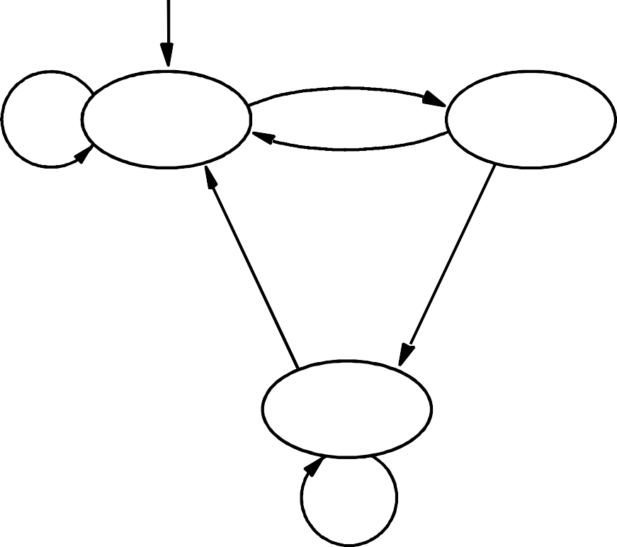
Example 1: A Simple Input Pattern (‘11’ Overlapping Sequence) Detection Circuit - Moore Type
State Diagram
Reset
w = 1
w = 0
^{A} ⁄ ^{z = 0}
^{B} ⁄ ^{z = 0}
w = 0
w = 0
w = 1
^{C} ⁄ ^{z = 1}
w = 1
Figure 5:
State diagram of a simple sequential circuit.

Slide 11
Example 1: A Simple Input Pattern (‘11’ Overlapping Sequence) Detection Circuit [State Table]
State Table
Present state | Next state |  |  |  |  |  | Output z
 | w | = | 0 | w | = | 1
A | A |  | B |  |  |  | 0
B | A |  | C |  |  |  | 0
C | A |  | C |  |  |  | 1
Note:
n bits can represent 2^{n} states.
Figure 6: State table for the sequential circuit in Figure 5.

Slide 12
Example 1: A Simple Input Pattern (‘11’ Overlapping Sequence) Detection Circuit [State Assigned Table]
We need to find expressions (K-map) for
next state (Y₂ ,Y₁)
output (z).
Present state
Next state
w=0 w=1
Output
z
Note that,
Y₁ = f(w,y₁,y₂)
Y₂ = f(w,y₁,y₂)
z = f(y₁,y₂)
 | y ₂ y ₁ | Y ₂ Y ₁ | Y ₂ Y ₁
A | 00 | 00 | 01 | 0
B | 01 | 00 | 10 | 0
C | 10 | 00 | 10 | 1
 | 11 | dd | dd | d
Figure 7:
State-assigned table for the sequential circuit in Figure 7.

Slide 13
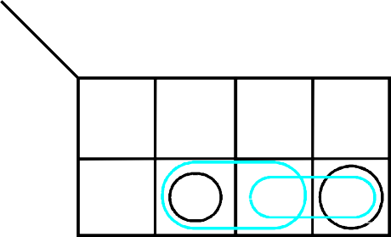
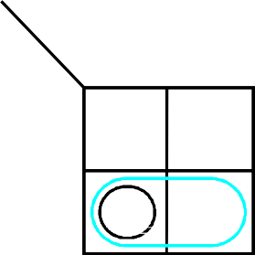
Example 1: A Simple Input Pattern (‘11’ Overlapping Sequence) Detection Circuit [K-Map]
y₂y₁
w
00 01 11 10
Ignoring don't cares
Using don't cares
0
0
0
d
0
Y ₁ = wy ₁ y ₂
Y ₂ = wy ₁y ₂ + wy ₁y ₂
z = y ₁ y ₂
Y ₁ = wy ₁ y ₂
Y ₂ = wy ₁ + wy ₂
= w ( y ₁ + y ₂)
z = y ₂
1
1
0
d
0
y₂y₁
w
00 01 11 10
0
0
0
d
0
1
0
1
d
1
y ₁
y ₂
0
1
0
0
0
1
1
d
Figure 8:
Derivation of logic expressions for the sequential circuit in Figure 7.

Slide 14
Example 1: A Simple Input Pattern (‘11’ Overlapping Sequence) Detection Circuit [Circuit]
Note that,
# flipflops = # bits to represent current state (#y)
Outputs of flipflops correspond to current state bits (y₁, y₂)
Inputs of flipflops correspond to next state bits (Y₁, Y₂)
In this problem, we need two flipflops as we have used two bits (y₁, y₂) to assign all the present states (A, B, C).

Slide 16
Example 1: A Simple Input Pattern (‘11’ Overlapping Sequence) Detection Circuit [Circuit]
Y₂
y₂
_ _
Y ₁ = wy ₁ y ₂
Y ₂ = w ( y ₁ + y ₂)
z = y ₂
D Q
z
Q
Y₁
y₁
w
D
Q
Q
Clock Resetn
Figure 9.
Final implementation of the sequential circuit derived in Figure 8.

Slide 17
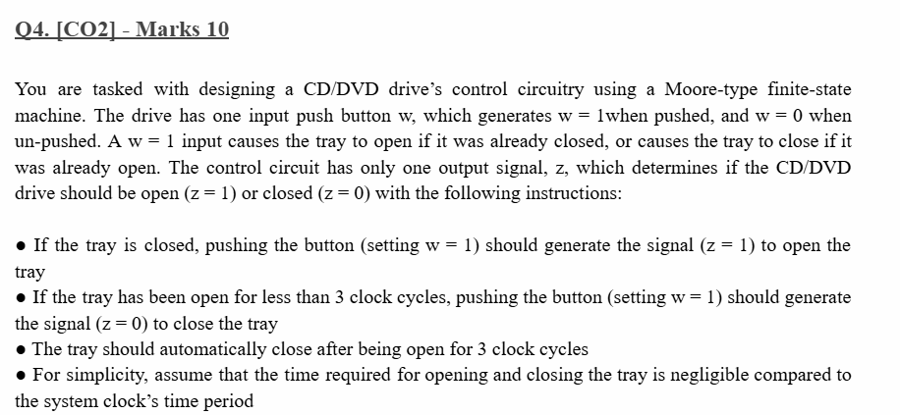

Slide 19
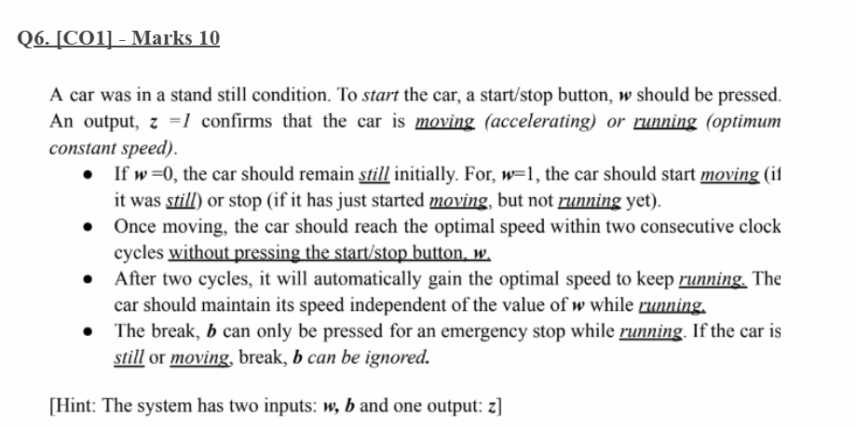

Slide 21
Summary
Steps->
State diagram
State table
State assigned table
K-map (next states & outputs)
Circuit

Slide 22
Example 1(cont.): A Simple Input Pattern (‘11’ Non-Overlapping Sequence)
(Detection Circuit - Moore Type)
NON-OVERLAPPING 1’s
Clockcycle: | t₀ | t₁ | t₂ | t₃ | t₄ | t₅ | t₆ | t₇ | t₈ | ^{t}9 ^{t}10
w : | 0 | 1 | 0 | 1 | 1 | 0 | 1 | 1 | 1 | 0 1
z : | 0 | 0 | 0 | 0 | 0 | 1 | 0 | 0 | 1 | 0 0
w
z
FSM
clk
Figure 4 :
Sequences of input and output signals.
w=1
w=1
C= two 1’s
w=0, NS=A; w=1, NS= B
z = 1
A= No 1
B= one 1
w=0, NS=A; w=1, NS= B
z = 0
w=0, NS=A; w=1, NS= C
z= 0
1st clkcycle
2nd clkcycle
3rd clkcycle
STATE DIAGRAM
w=0
w=0
w=0
w=1
A/z=0
B/z=0
C/z=1
w=1
w=1

Slide 23
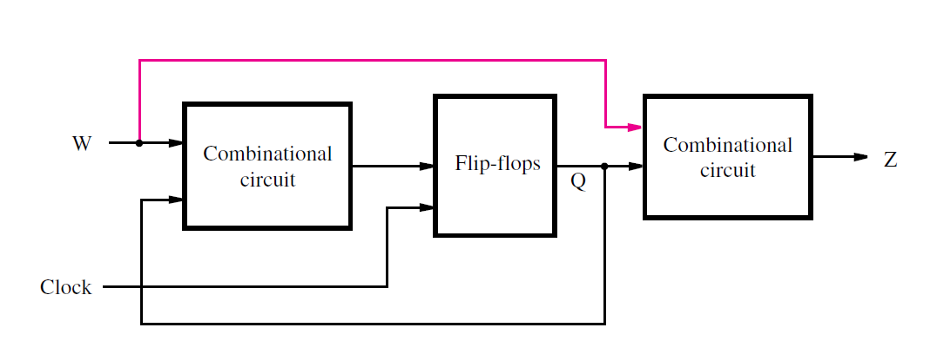
General form of a sequential circuit
W represents input/s
Z represents output/s
Flip-flops are used to save the “present” state of the circuit, Q
Also called Finite State Machine (FSM) or simply, machine
2 types: depending on the connection drawn in pink on the circuit
Figure: General form of a sequential circuit

Slide 24
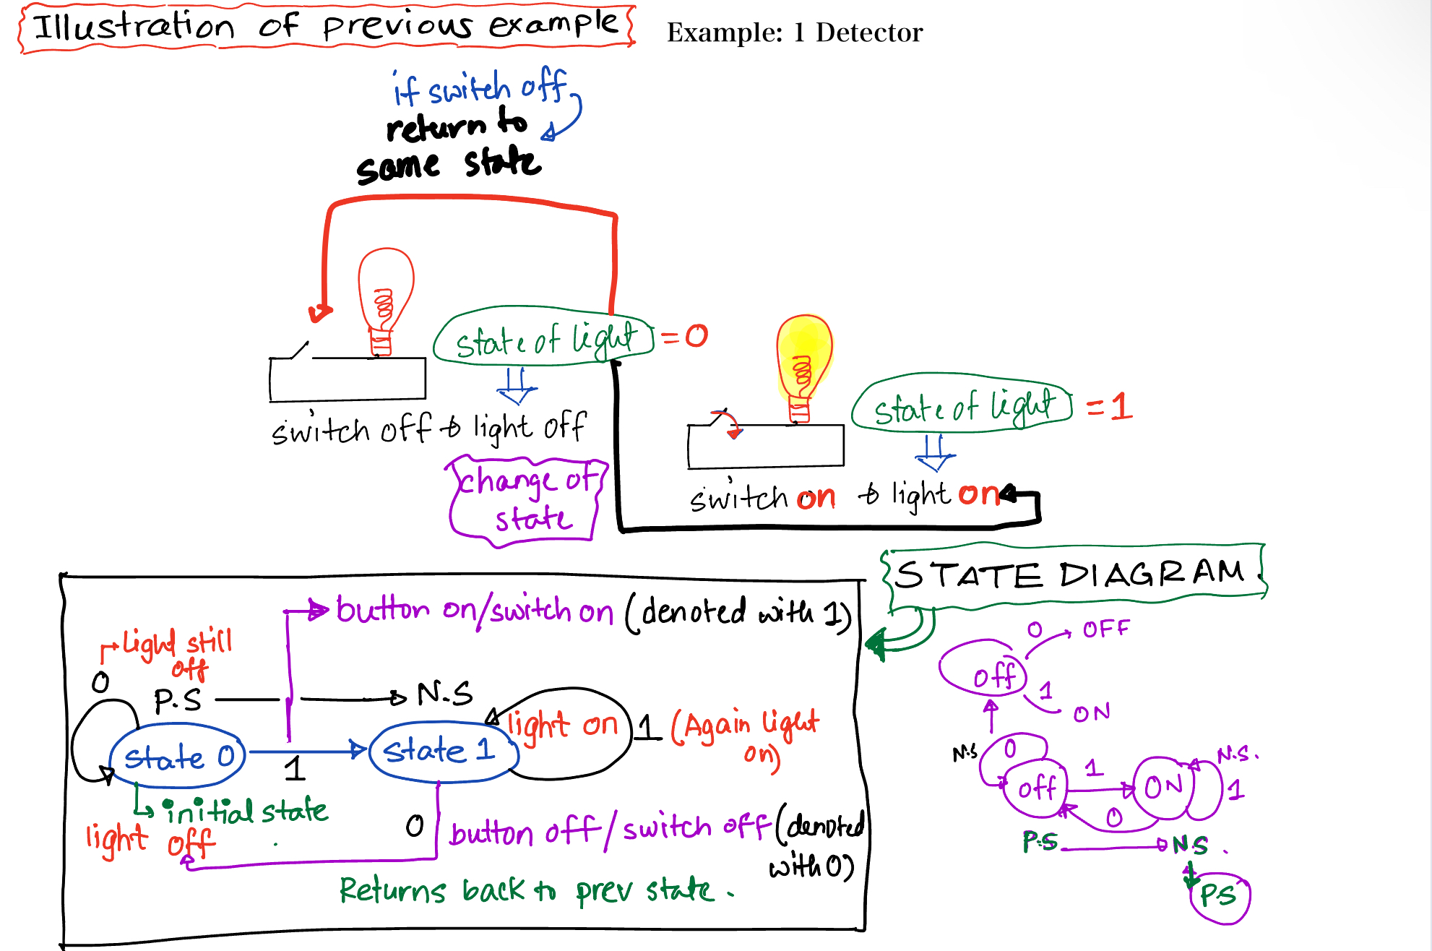
Illustration of light switch problem

Slide 25
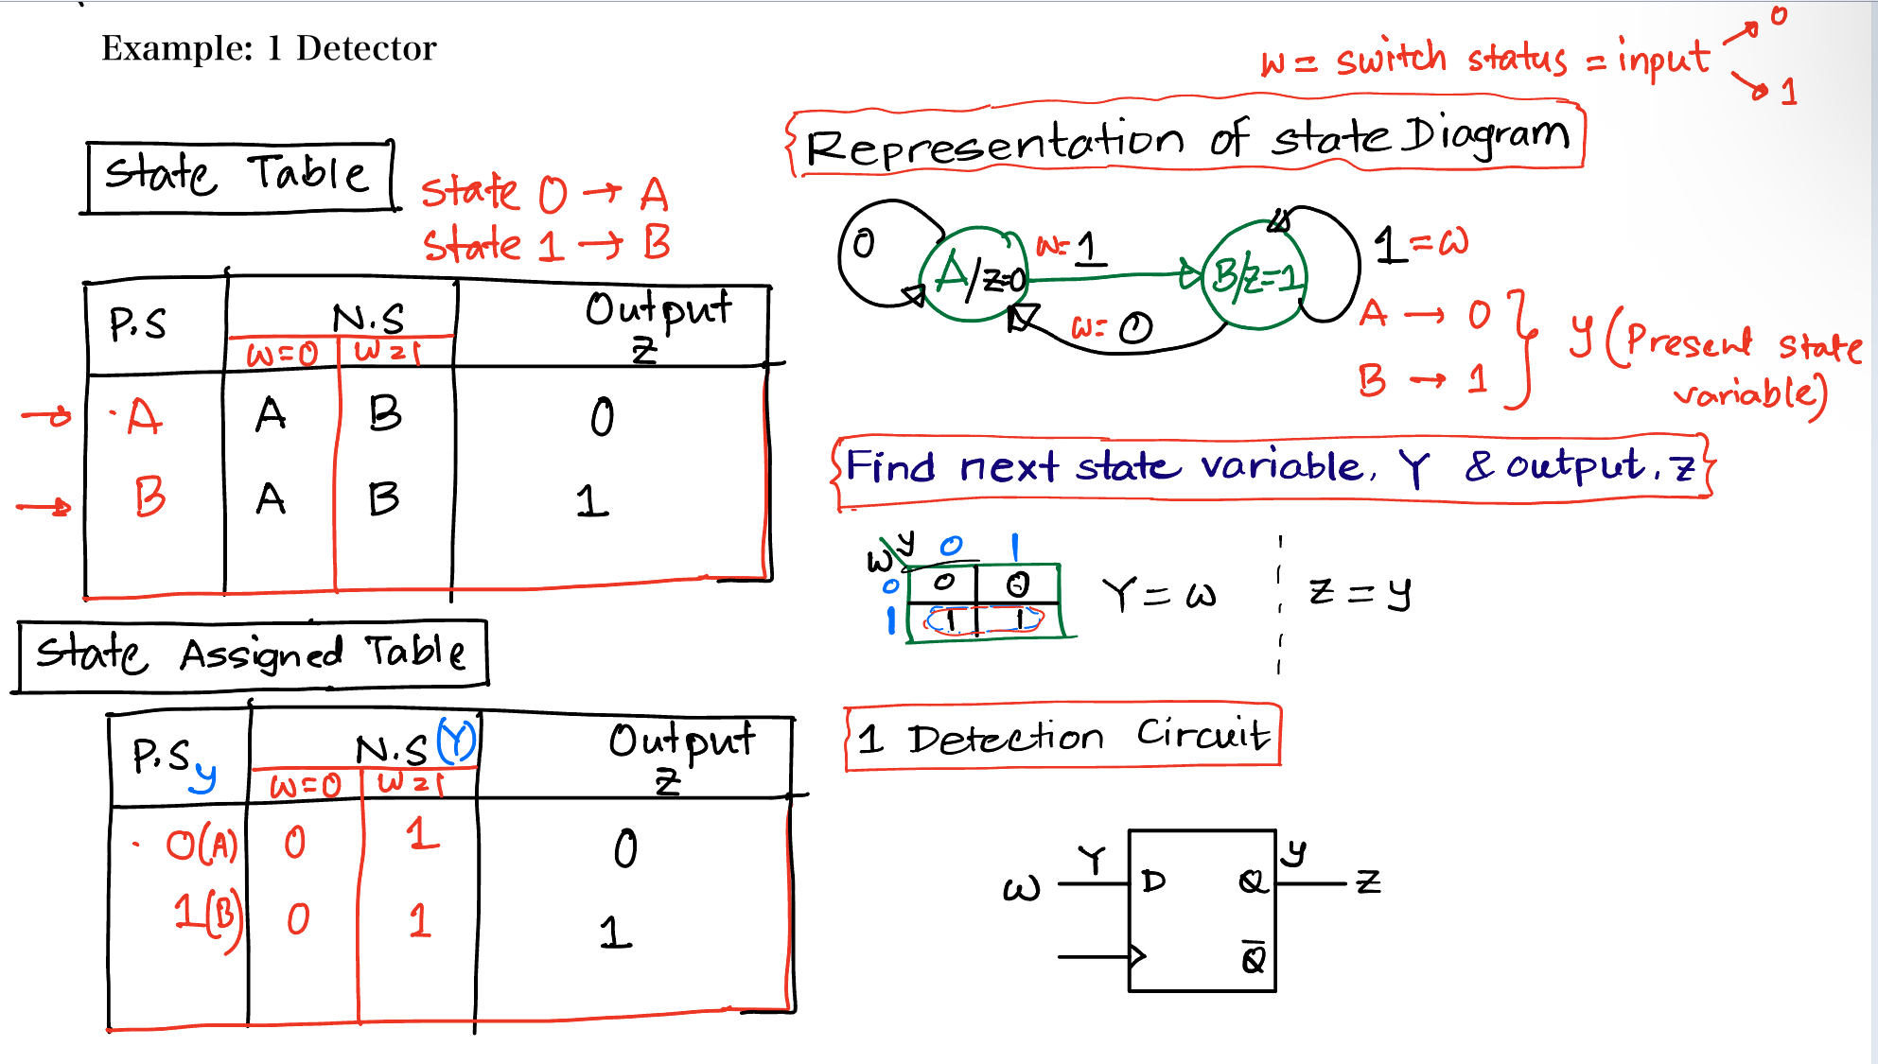

Slide 26
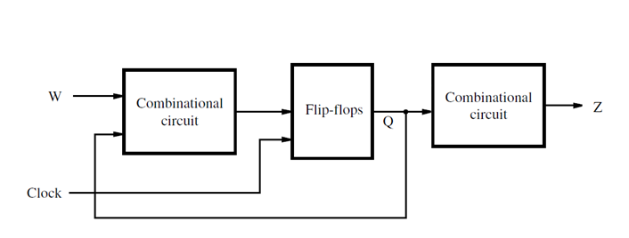
FSM types
Moore type FSM
Output (Z) depends only on the “present” state (Q) of the circuit
Mealy type FSM
Output (Z) depends on both the primary inputs (W) and the “present” state (Q) of the circuit
Figure: Moore type FSM
Figure: Mealy type FSM

Slide 27
Moore vs. Mealy type machines
Moore Machine | Mealy Machine
Output depends only on the present state. | Output depends both on the present state and the present input.
Generally, it has more states than Mealy Machine. | Generally, it has fewer states than Moore Machine.
The output is a function of the current state and changes at clock edges | The output is a function of the transitions and can change any instant
In Moore machines, more logic is required to decode the outputs resulting in more circuit delays. They generally react one clock cycle later. | Mealy machines react faster to inputs. They generally react in the same clock cycle.

Slide 28


Slide 29
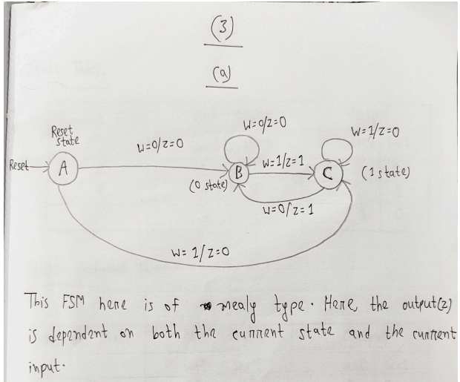

Slide 30
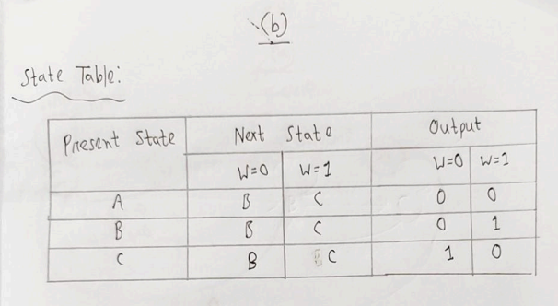

Slide 31
